Slide 1

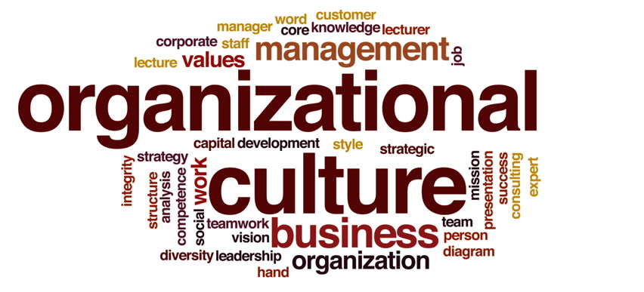
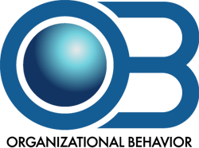
Organizational Culture
Instructor: Dr. Muhammad Rafiq
Chapter 16: Organizational Behavior – 15th Edition

Slide 2
What Is Organizational Culture?
Organizational Culture
A common perception held by the organization’s members; a system of shared meaning.
Characteristics:
Innovation and risk taking
Attention to detail
Outcome orientation
People orientation
Team orientation
Aggressiveness
Stability
The shared social knowledge within an organization regarding the rules, norms, and values that shape the attitudes and behaviors of its employees.
Notes:
Organizational culture is an important concept in studying how organizations behave. Culture has significant impact on how individuals interpret the impact of their behavior and make decisions about their actions. Culture is defined as a common perception held by the members of the organization or a sense of shared meaning.
Cultures have 7 primary characteristics that define the organization. They are: innovation and risk taking, attention to detail, outcome orientation, people orientation, team orientation, aggressiveness, and stability.

Slide 3
Do Organizations Have Uniform Cultures?
Dominant Culture
Subculture
Expresses the core values that are shared by a majority of the organization’s members.
Minicultures within an organization, typically defined by department designations and geographical separation.
Notes:
There are several different groupings that most cultures fit into. These groups describe the organization in an effort to help increase the understanding of how an organization works. There are different aspects of culture that need to be defined to help lay a foundation for understanding what culture is.
Dominant culture is the core values that are shared by the majority of employees in the organization.
Subcultures are when there are a variety of different cultures within the organization. These subcultures typically are divided by department and/or geographical separation.
Core values are the primary values that most people in the organization accept.
A strong culture is one in which the core values are intensely held and shared by most.
These definitions are key components of a culture and will help you further understand organizational culture.

Slide 4
Do Organizations Have Uniform Cultures?
Core Values
Strong Culture
The primary or dominant values that are accepted throughout the organization.
A culture in which the core values are intensely held and widely shared.
Notes:
Core values are the primary values that most people in the organization accept.
A strong culture is one in which the core values are intensely held and shared by most.
These definitions are key components of a culture and will help you further understand organizational culture.

Slide 5
What Is Organizational Culture?
Culture Versus Formalization
A strong culture increases behavioral consistency and can act as a substitute for formalization.
Organizational Culture Versus National Culture
National culture has a greater impact on employees than does their organization’s culture.
Nationals selected to work for foreign companies may be atypical of the local/native population.

Slide 6
What Do Cultures Do?
Culture’s Functions
Culture as a Liability
Defines the boundary between one organization and others.
Conveys a sense of identity for its members.
Facilitates the generation of commitment to something larger than self-interest.
Enhances the stability of the social system.
Serves as a sense-making and control mechanism for fitting employees in the organization.
Institutionalization
Barrier to change.
Barrier to diversity
Barrier to acquisitions and mergers
Notes:
Cultures take on distinct functions. Some of the things that cultures do are defining the boundary between one organization and others. They also convey a sense of identity for the members of the organization. If the cultures are strong, they can facilitate a continuous commitment to something larger than self-interest over an extended period of time. Cultures also help people know what to expect in the organization and can thereby enhance the stability of the social system. Through doing this, it can also serve as a sense-making and control mechanism for fitting employees into the organization.
Culture can also be a hindrance to an organization. A company can become institutionalized when people value the organization more than what they provide. When cultures are strong, they can become a barrier to change as their values may not align with the values needed to embrace or facilitate the change. Cultures that may pressure employees to conform can be a barrier to hiring, developing, and promoting a diverse workforce. Finally, if a merger or acquisition occurs, one of the most difficult things to do is to merge the two cultures, causing many mergers to fail.

Slide 7
How Culture Begins
Stems from the actions of the founders:
Founders hire and keep only employees who think and feel the same way they do.
Founders train and socialize these employees to their way of thinking and feeling.
The founders’ own behavior acts as a role model that encourages employees to identify with them and thereby internalize their beliefs, values, and assumptions.

Slide 8
Keeping Culture Alive
Selection
Concern with how well the candidates will fit into the organization.
Provides information to candidates about the organization.
Top Management
Senior executives help establish behavioral norms that are adopted by the organization.
Socialization
The process that helps new employees adapt to the organization’s culture.

Slide 9
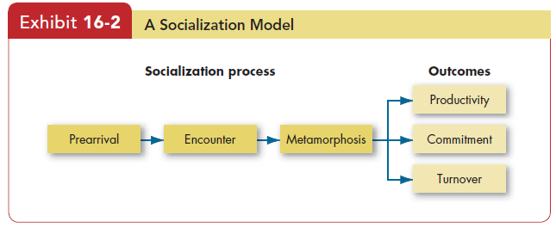
Stages in the Socialization Process

Slide 10
Stages in the Socialization Process
Prearrival Stage
The period of learning in the socialization process that occurs before a new employee joins the organization.
Encounter Stage
The stage in the socialization process in which a new employee sees what the organization is really like and confronts the possibility that expectations and reality may diverge.
Metamorphosis Stage
The stage in the socialization process in which a new employee changes and adjusts to the work, work group, and organization.

Slide 11
How Employees Learn Culture
Stories
Anchor the present into the past and provide explanations and legitimacy for current practices
Rituals
Repetitive sequences of activities that express and reinforce the key values of the organization
Material Symbols
Acceptable attire, office size, opulence of the office furnishings, and executive perks that convey to employees who is important in the organization
Language
Jargon and special ways of expressing one’s self to indicate membership in the organization
Notes:
Employees learn the organizational culture through a number of avenues. They can gain an understanding of culture by hearing stories that present the past and provide explanations for current practices. Rituals, or repetitive sequences of activities, can reinforce the key values of the organization and provide insight into the culture. Material symbols such as dress codes, formal or informal, office size or style, and perks for key employees can denote who is important in an organization.
Language is another way to learn about organizational culture as employees will express themselves in certain ways to indicate membership in the organization.

Slide 12
Creating An Ethical Organizational Culture
Characteristics of Organizations that Develop High Ethical Standards
High tolerance for risk
Low to moderate in aggressiveness
Focus on means as well as outcomes
Managerial Practices Promoting an Ethical Culture
Being a visible role model.
Communicating ethical expectations.
Providing ethical training.
Rewarding ethical acts and punishing unethical ones.
Providing protective mechanisms.

Slide 13
Creating a Customer-Responsive Culture
Key Variables Shaping Customer-Responsive Cultures
The types of employees hired by the organization.
Low formalization: the freedom to meet customer service requirements.
Empowering employees with decision-making discretion to please the customer.
Good listening skills to understand customer messages.
Role clarity that allows service employees to act as “boundary spanners.”
Employees who engage in organizational citizenship behaviors.

Slide 14
Creating a Customer-Responsive Culture (cont’d)
Managerial Actions :
Select new employees with personality and attitudes consistent with high service orientation.
Train and socialize current employees to be more customer focused.
Change organizational structure to give employees more control.
Empower employees to make decision about their jobs.

Slide 15
Creating a Customer-Responsive Culture (cont’d)
Managerial Actions (cont’d) :
Lead by conveying a customer-focused vision and demonstrating commitment to customers.
Conduct performance appraisals based on customer-focused employee behaviors.
Provide ongoing recognition for employees who make special efforts to please customers.

Slide 16
Spirituality and Organizational Culture
Workplace Spirituality
The recognition that people have an inner life that nourishes and is nourished by meaningful work that takes place in the context of the community.
Characteristics:
Strong sense of purpose
Focus on individual development
Trust and openness
Employee empowerment
Toleration of employee expression

